Slide 1
Securing data hiding images using steganography
CAPSTONE PROJECT
Presented By:Ganti Venkat Charan Kumar
Student Name : Ganti Venkat Charan Kumar
College Name & Department : SCSVMV University

Slide 2
OUTLINE
Problem Statement
Technology used
Wow factor
End users
Result
Conclusion
Git-hub Link
Future scope

Slide 3
Problem Statement
With the increasing exchange of digital information, the need for secure communication has become more critical than ever. Traditional encryption techniques protect data from unauthorized access but may attract unwanted attention. Steganography, the practice of hiding information within digital media, offers a covert way to secure sensitive data

Slide 4
Technology used
Python
Open CV
OS
String
Image Processing
Steganography
Basic Cryptography
Pixel Manipulation
File Handling

Slide 5
Wow factors
Simple Yet Effective Character-Based Encoding
Password-Based Decryption
Minimal Image Distortion
No Additional Software Dependencies
Platform Independence & Open source Implementation
Interactive Message Encoding & Decoding
Easily extendable for Future Enhancements

Slide 6
End users
Government Agencies for Secure Communication
Journalists & Whistleblowers for Confidential Data Exchange
Military & Intelligence Services
Corporate Sector for Protecting Sensitive Information
Individuals Concerned with Personal Data Security

Slide 7

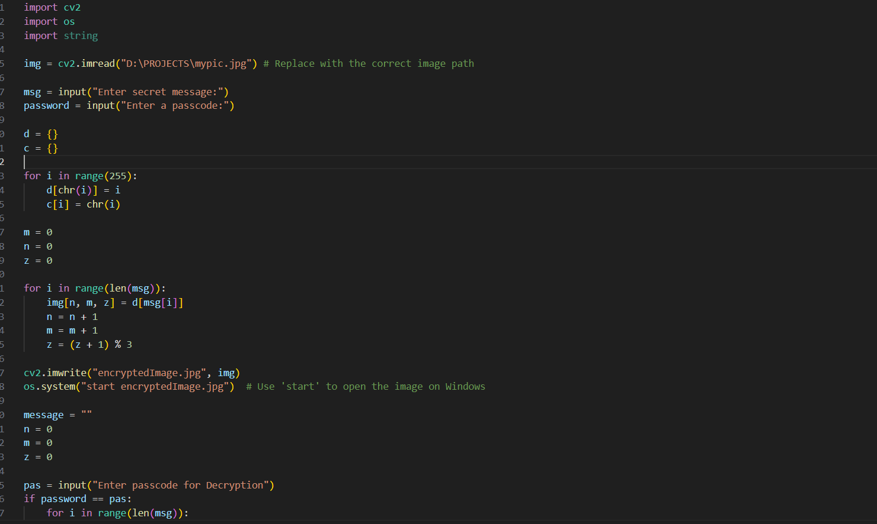
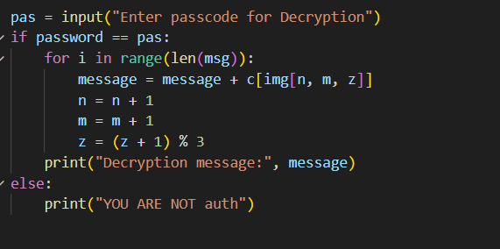
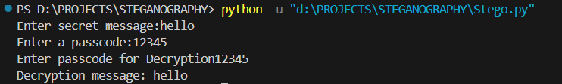
Results
Screenshots of the outcome (min 3)

Slide 8
Conclusion
This project successfully demonstrates the use of steganography for secure communication. By leveraging image-based data hiding techniques, it provides a covert method of transmitting sensitive information while maintaining the integrity of the cover image. The system ensures data security while offering a simple and efficient implementation for real-world applications.

Slide 9
GitHub Link
Make sure that there should be readme file

Slide 10
Integration with Advanced Encryption Standards
Support for Audio & Video Steganography
Cloud-Based Secure Data Transmission
AI-Based Image Selection for Optimal Data Hiding
Future scope(optional)

Slide 11
THANK YOU

